Slide 1


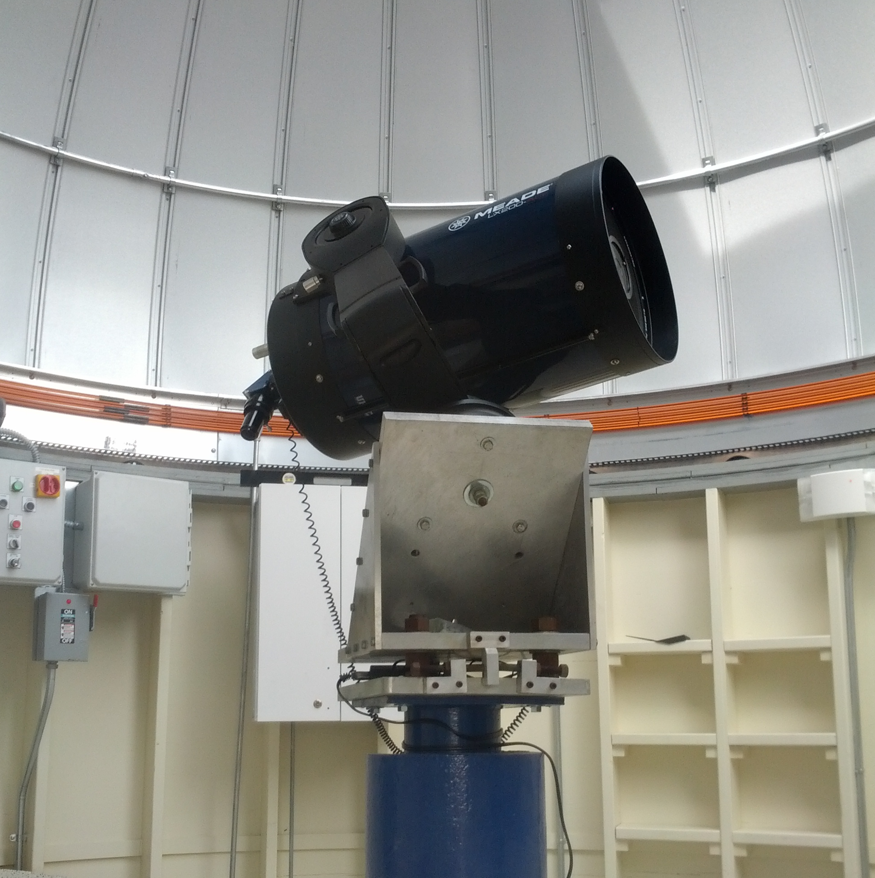
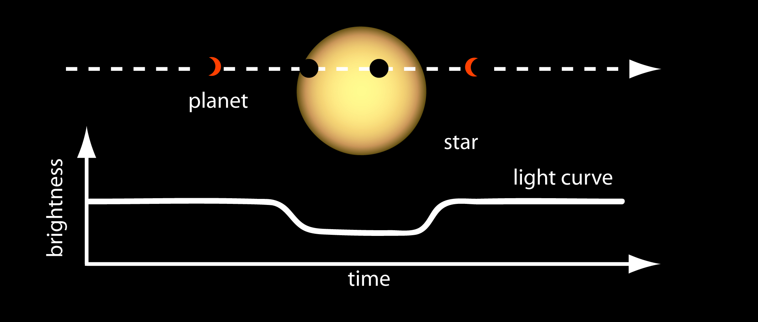
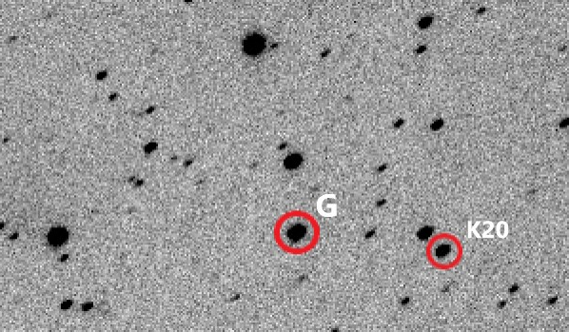
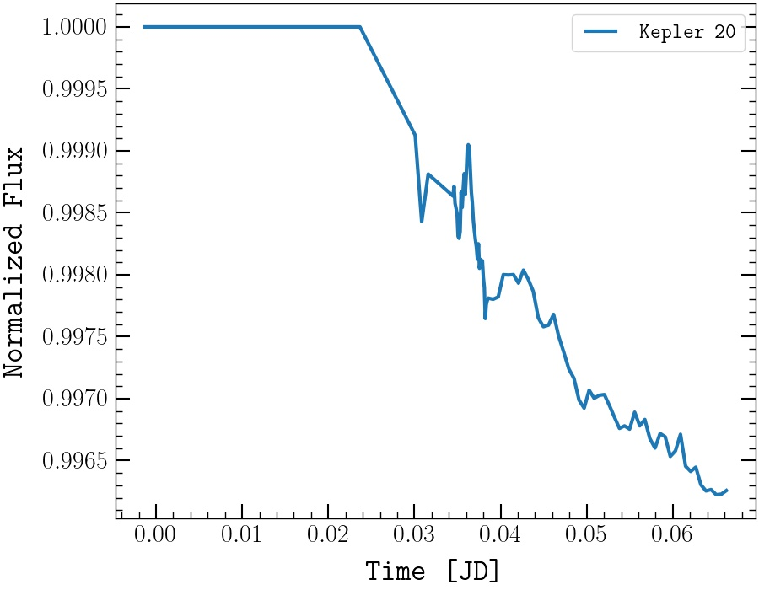
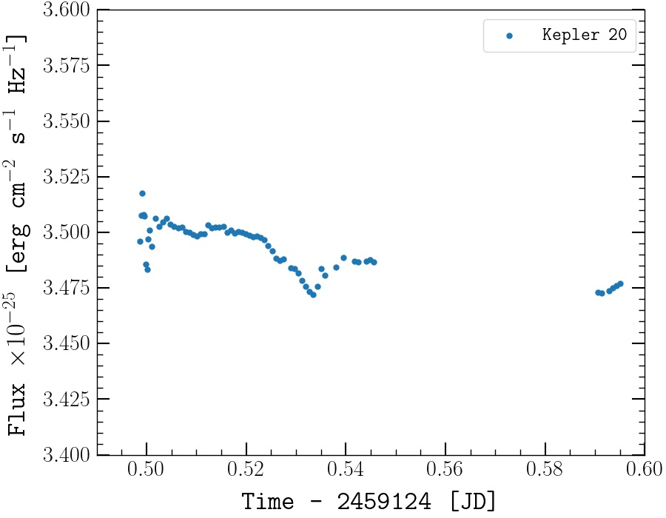
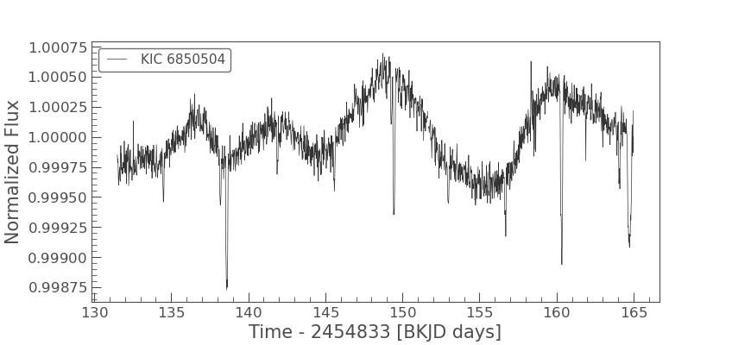
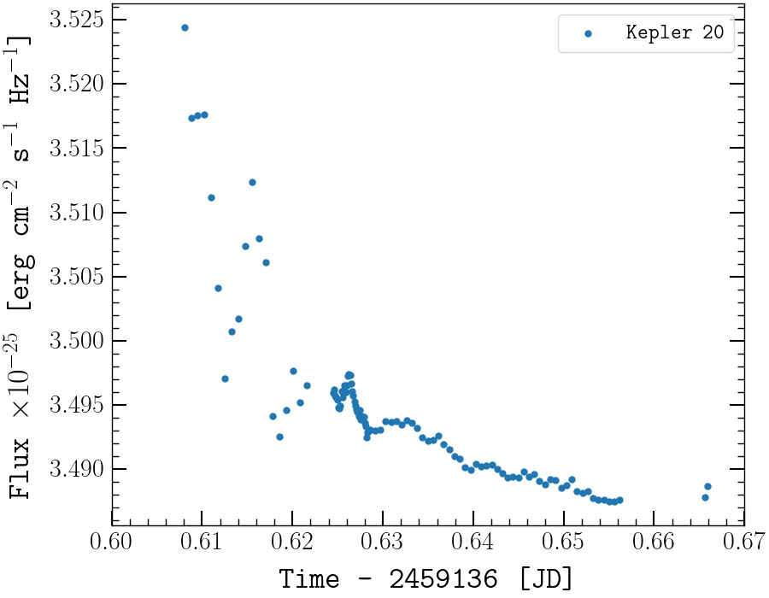
A snapshot of the multi-exoplanet
system Kepler-20
Zachary Stone
Stony Brook University AST 443
Introduction
Observations
Discussion
Introduction
One of the most solar-like planetary systems found so far is that of Kepler 20. First discovered by the Kepler mission in 2011, this star now has six known orbiting planets. Along with the fact that Kepler-20 is a G8 solar-type star, this system can be used to inform us about many aspects of planet formation and habitability. All but one of these planets have been discovered via the transit method, granting estimates of their mass and distance from their host star. The transit method identifies exoplanets by observing the change in brightness of its host star, when the planet crosses our line of sight.
All of the planets orbiting Kepler-20 have an average orbital distance less than 1 AU. Subsequently, all of these planets are too close-in to be within Kepler-20’s habitable zone. However, the planetary dynamics of these objects are particularly interesting, as they are so close that the gravitational effects they feel from each other are larger than seen in our solar system.
From the observation of these six planets, we have been able to surmise the temperatures of these planets, as well as estimates of their atmospheres. We have also learned many of the nuances of the transit method, as variability due to six different transits on different timescales can bring about a unique, chaotic light curve.
Observations
We observed for two nights in October at the Mt. Stony Brook Observatory: 10/1/2020 between 8:00 PM and 12:00 AM and 10/13/2020 between 12:00 AM and 1:30 AM
Using the SBIG STL-1001E CCD, we took images of Kepler-20 using 5s exposures, and switched to 60s weather-permitting
Observations were done solely in the Johnson’s V-band filter
Observations lasted three hours on both nights of observation, being halted by cloudy weather
Proper data analysis was done to flat-field correct the images
Guide star TYC 3129-1100-1 was used to adjust the flux of Kepler-20
Results
Results
The seeing at Mt. Stony Brook was acceptable on both nights, though clouds intermittently crossed our line of sight with the target, granting uncertainty in some portions of our data.
There were no transits for the observations on night one, so this data allows us to get a feel for the uncertainty on measurements with the telescope
This data remains somewhat constant throughout the first observation, but displays a slight decrease overtime
The second observation starts around the time of a transit for Kepler-20 b. We can see a sharp decrease in the flux around midnight, which is when we had started aggregating data.
This shows a rounded decrease due to limb darkening. An initial sharp decrease is not distinctly seen, but inferred by the sparsely distributed data from the beginning of the second night
Using the median flux from the first night as a constant value and removing the outliers from the second night grants us a decent light curve for the start of a transit
We can see a clear decrease in the flux of Kepler-20, and not by a significantly large value, only about 3%
Fitting for a linear curve grants a chi-squared value of 203 per degree of freedom, with a confidence level of < .01. This suggests that the data from the second night of observations is not simply decreasing as the flux had from the first night.
Using the data from the first night to get an average decrease in flux grants an even lower level of confidence
It should be noted that a change in exposure time, due to the weather at the Mt. Stony Brook Observatory, introduces more uncertainty into the data. The data taken on the first night was initially done with 5s exposures, then switched to 60s exposures for the remainder of the night. This lower exposure time introduced more uncertainty into the data, and may account for the initial variation. This occurred in reverse on the second night, where we had switched from 60s to 5s exposures. In this case, 60s exposures offered more uncertainty due to the cloud cover at the time. In both cases, cloud cover was the main source of uncertainty in the flux measurement and the quality of the images taken.
Discussion
We have not fulfilled the requirement for a Nyquist sampled dataset, meaning that we cannot confirm the transit of Kepler-20 b
Datasets from both observations were affected by strong cloud cover, intermittent throughout the whole night
The initial observation shows a steady decrease in flux overtime, which may be due either to the telescope, weather, or data processing techniques
Normally, the transits from Kepler-20 b would only decrease the flux by about 1% the normal value, while our interpolation has granted a decrease of about 3.5%
This increased flux decrease could be due to an error in the data processing techniques, which would have scaled everything by a certain factor. In this case, the percent decrease in flux could be larger or smaller than the observed decrease
The initial decrease in flux seen in night one may have been from an eclipse from another planet in the system or a sunspot, though this is highly unlikely due to how small the effects are.
The observed transit may be due to the star’s position on the sky, as toward the end of the night of observation, the target was relatively low in the sky
Planet | Transit Times Near Night 1 | Transit Times Near Night 2
b | 10/2 9:11 PM – 12:35 AM | 10/13 11:55 PM – 2:43 AM
c | 10/5 11:25 PM – 3:25 AM | 10/16 7:55 PM – 11:56 PM
e | 9/10 11:39 PM – 2:32 AM | 10/23 4:14 PM – 7:07 PM
The 14” Schmidt-Cassegrain telescope located at the Mt. Stony Brook Observatory. Used on both 10/1 and 10/13.
Planet | Period (days)
b | 3.7
c | 10.9
d | 77.6
e | 6.1
f | 19.6
g | 34.9
Conclusions
Despite all of the uncertainty in the data from the weather and the initial decrease of the flux on a night without a transit, there is evidence to signify that a transit was observed
The first night of observation gave a general baseline flux to be used for comparison for the second night of observation. We observed the initial decrease in the flux of Kepler-20 due to one of its smaller planets, though this decrease is notably higher than previously recorded.
The decrease was proven to be unlikely to be related to the decrease on the first night, as a fit to a linear decrease granted a very low level of confidence
Not being able to view the second half of the transit suggests that there is uncertainty that this is actually a transit. This data is very under sampled, as only half of the transit, or less, was seen. This observation lasted for only a few hours due to very cloudy skies, meaning that only an initial decrease was seen.
More careful modeling of the data to relevant formulae for transit light curves may reveal indications of a false-positive
Overall, this transit event displays one of the main ways in which exoplanets are found, and how their properties are measured. In order to successfully match one of the light curves from Kepler-20, we would have needed substantially more data over a longer period of time. This data still displays variability in the brightness of Kepler-20, signaling that its system contains exoplanets. With a complete light curve, we would be able to determine the semi-major axis of these planets, the period, and perhaps even its temperature. Currently, measuring exoplanets is very feasible for even amateur astronomers with enough accuracy in measuring flux. The prospects from measuring exoplanets are exciting and can aid in the search for another habitable world like ours in the Universe.
Diagram depicting the transit of an exoplanet and a table of the periods for all of the planets surrounding Kepler-20
Conclusions
One of the 60s exposures from the second night of observation. “G” represents the guide star and “K20” represents Kepler-20.
Objectives
We aim to detect the variation in the brightness of Kepler-20, and observe some of the many transits that take place in its system. Seeing as five planets transit in front of Kepler-20, each with a different orbital period, the variation in its observed brightness is quite hectic.
The periods of the planets within Kepler-20’s system are well-known, so we seek to verify these values.
Normally, by observing the transit depth and transit time, we would be able to determine the period of these planets and their radii. However, seeing as the variation I brightness is so hectic, we seek to verify the light curves given off by Kepler-20.
The challenges presented by the weather at the location of observation also present an issue of visibility, so we wish to only observe and verify only a portion of this light curve.
Objectives
Using the data from the first night to represent the baseline flux of the star, this is the curve we see from the second night. Outliers have been removed to make the decrease in flux more apparent.
Observations from the first night. Data collected after midnight is severely affected by cloud cover. No variations are seen as there is no transit.
Observations from the second night, 10/13. Initial data collected is severely affected by cloud cover. The decrease in flux is due to the transit of
Kepler-20 b.
An example of a light curve from Kepler-20, taken from the first quarter of the Kepler mission over approximately 35 days. The transit curves are very chaotic due to the overlap of transits for multiple planets.
All images have been flat-field corrected, and all data of raw counts have been converted to flux using the guide star. Error bars are too small to be seen on each data point.

